Slide 1
CCR OIT Systems
PRES, CRMS, PDTS and Protocol View

Slide 2
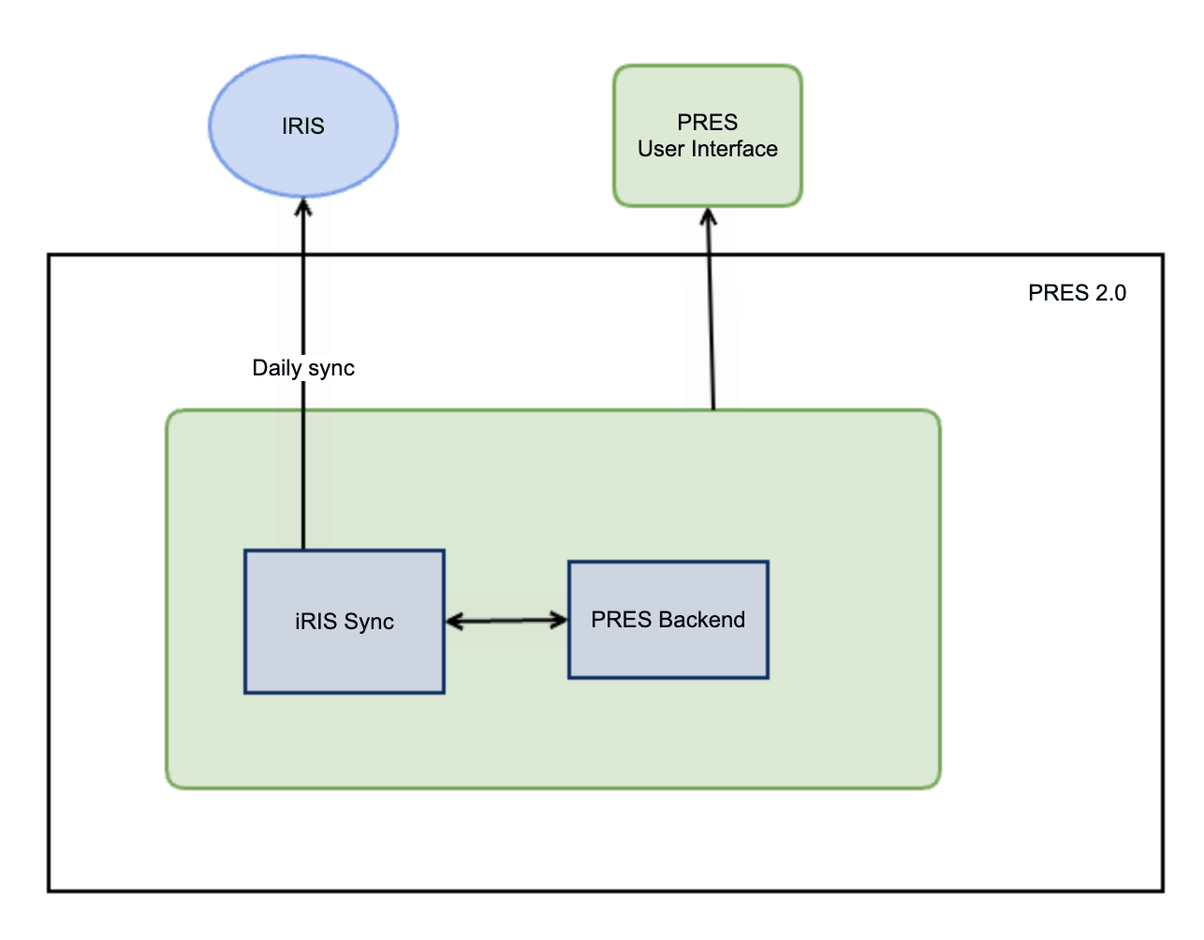

Slide 3
Development and Migration to PRES 2.0
PRES 2.0 was rewritten with latest technologies and it removed LabMatrix as database/backend system. It also improved security (over legacy code) and better maintainability.
CDR to PRES 2.0 migration started in August 2020 and completed in May 2021

Slide 4
Evolution of Architecture
Eventually PRES evolved into multiple systems despite sharing common backend. Think of each system as a module in new system
1. PRES (Patient Registration and Enrollment System)
2. PDTS (Protocol Deviation Tracking System)
3. CRMS (Clinical Research Management System)
3. New Protocol View (Replaced Old Protocol View)

Slide 5
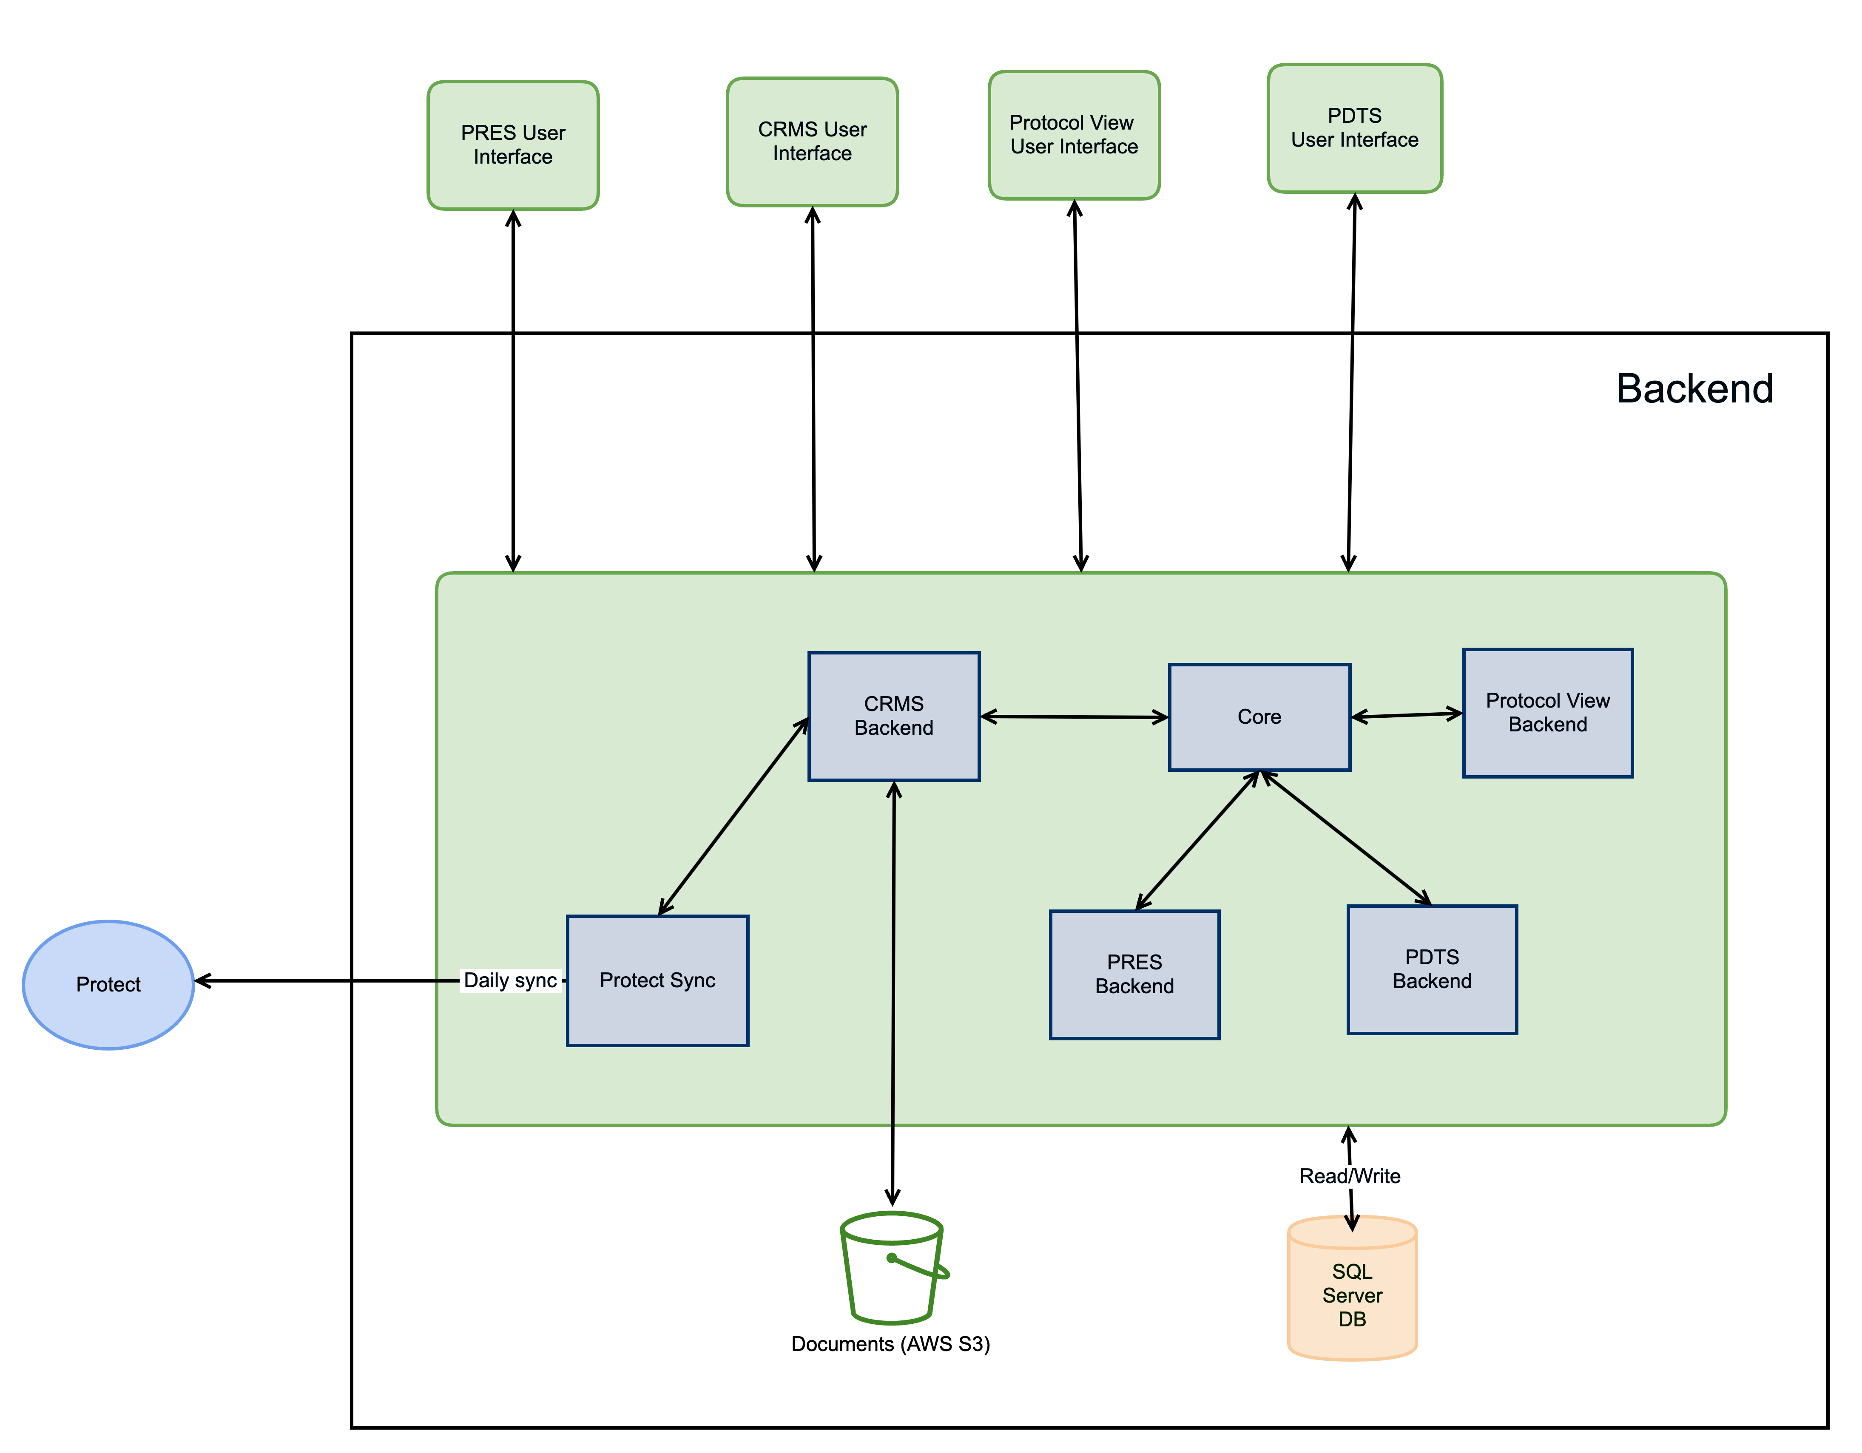

Slide 6
PRES
Allows users to register patients onto different protocols and note notable events
Provides different reports to get enrollments, count accruals etc…
CC Pharmacy users can login and verify the Cohort/Arm information
Can be accessed via https://pres.ccr.cancer.gov/

Slide 7
PDTS
Houses protocol deviation information and oversee by Liz Ness and team
Gives users the ability to record protocol deviations
Provides different reports to count deviation accruals by branch, PI, year etc…
Can be accessed via https://pdts.ccr.cancer.gov

Slide 8
CRMS
Houses protocol information
Gives the PSO ability to manage and update protocol information
Provides different reports on protocols and MODS
This is Work in Progress and not available to all users
Can be accessed via https://crms.ccr.cancer.gov/

Slide 9
Protocol View
This is replacement to old Protocol View
Rolled out when PROTECT went live
Anyone from NCI can login and view basic protocol information, links to PQS, CT.gov and consent documents website
Also surfaces protocol documents
Can be accessed via https://protocols.cancer.gov

Slide 10
Summary
In summary
  PRES is for enrollment data
  CRMS is for protocol data
  PDTS is for Deviation data
  Protocol View is to view protocol documents for NCI users

