Slide 1
SAS JReview

Slide 2
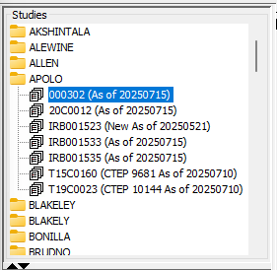
Selecting a folder
Studies are organized in folders, based on PI’s last name
Naming Convention:
  Rave EDC Studies: shown directly the study name
  Theradex Studies: begin with T
  C3D Archived Studies: begin with C
As of date:
  Shows the cutoff date of data
  Date will not be refreshed if no data entry happen
  Closed studies show “Closed” instead of “As of ”

Slide 3
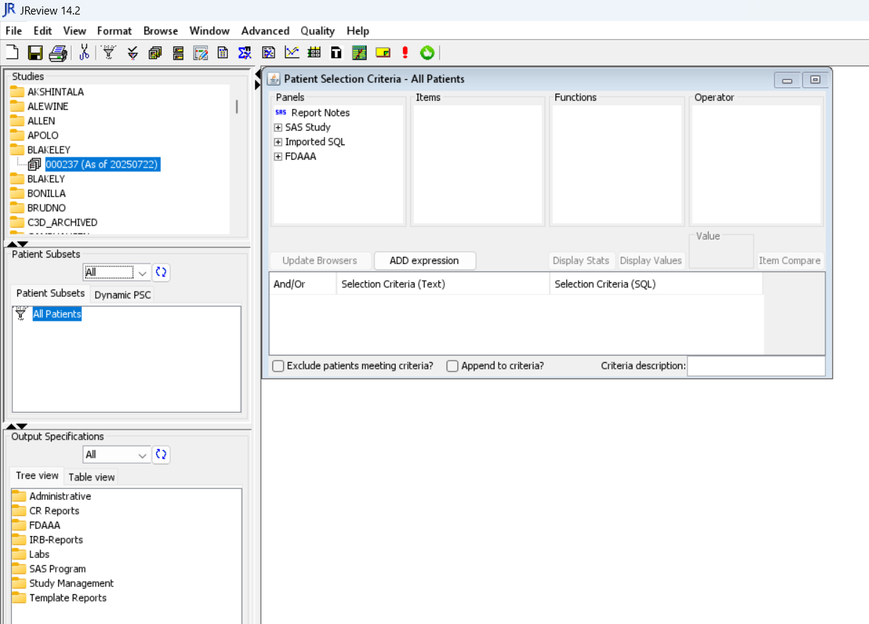
Canned Reports
Canned reports can be found in Output Specifications
Folder | Reports | Description
Administrative | Study by PI All Table Columns | Study by PI: To check which folder (PI) a study belongs to All Table Columns: Lists out all fields in the forms selected
CR Reports | CR AE/SAE Count Report CR Report | CR AE/SAE Count Report: Total number of serious and all adverse events CR Report: # of Events related to Research since Last CR Reporting (date of last report and current cut-off date entered by user)
IRB-Reports | AE Summary – FDA | AE Summary reports: sum of adverse event for each AE, grade, IND, Serious. For reports with more than 2 INDs, customization will be needed.
Labs | Lab Datalisting + Course Num/Day | These reports are built for older studies that don’t have course info derived. Course info will be derived in this report (for multi-lab panel studies, this report is created in study specific level)
Template Reports |  | Various data listing reports are available

Slide 4
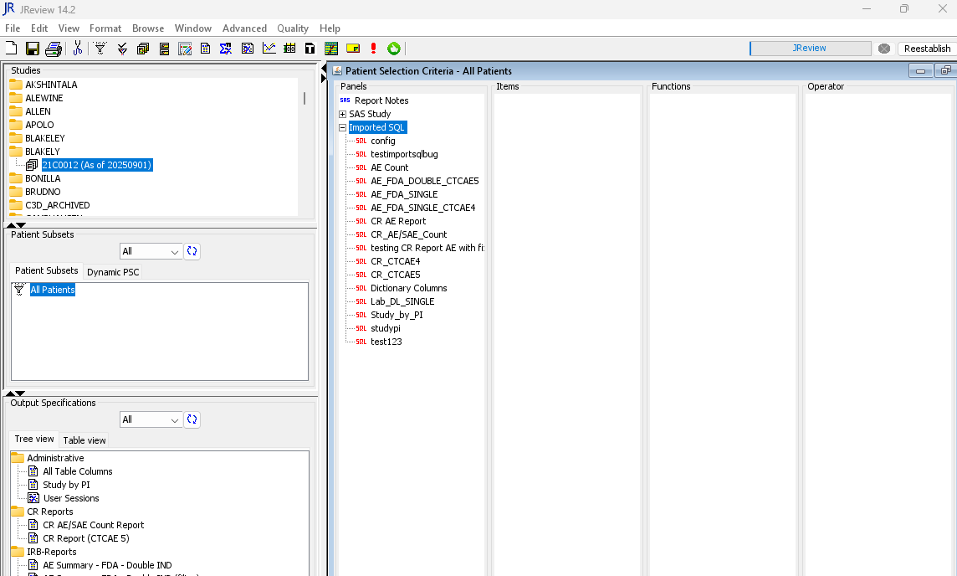
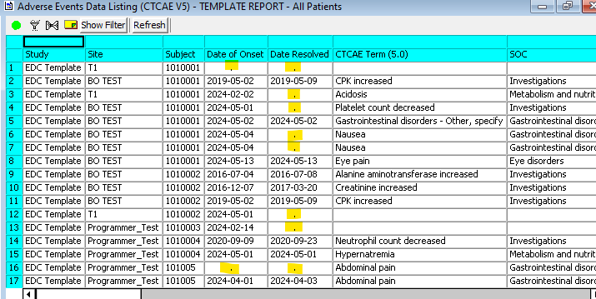
Running Reports
Double click on the report in output specification to run
Note: Blank date/numeric fields will show “.”

Slide 5
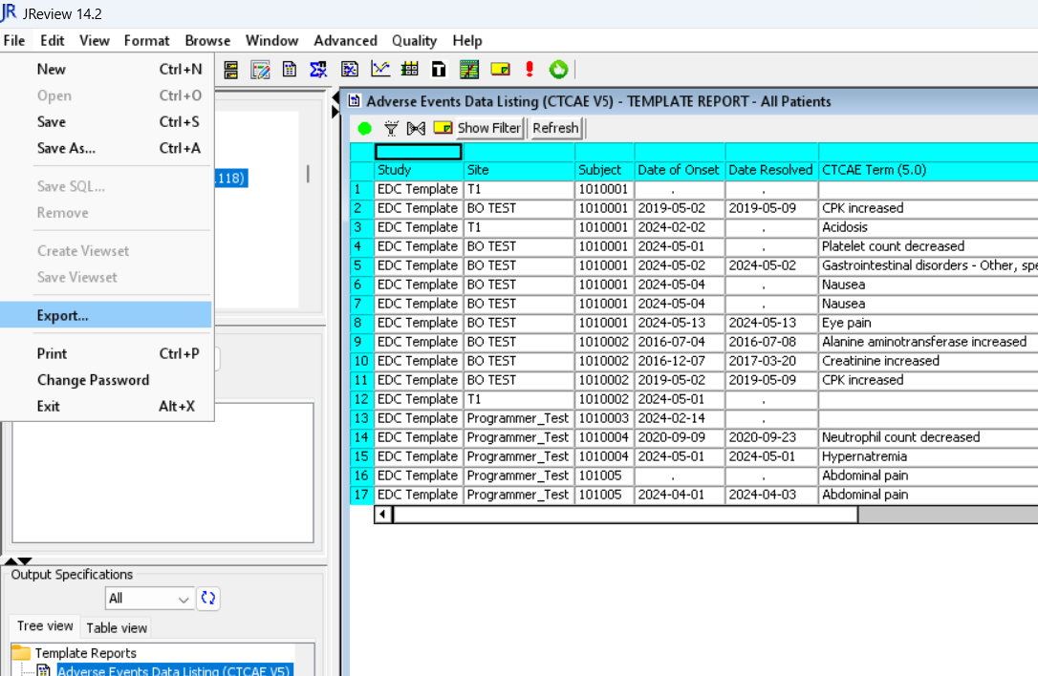
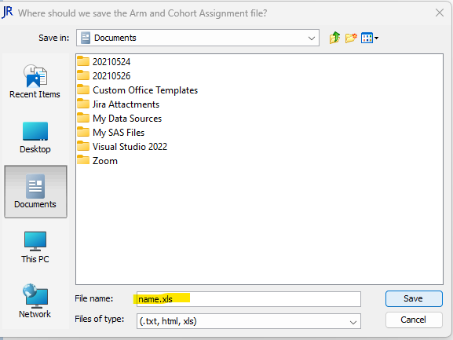
Running Reports - Export
To export reports, select “Export”
from the File drop down menu.
Select a location to save the file, then enter the file name.
Hit Save
Note: Make sure to add “.xls” in the file name

Slide 6
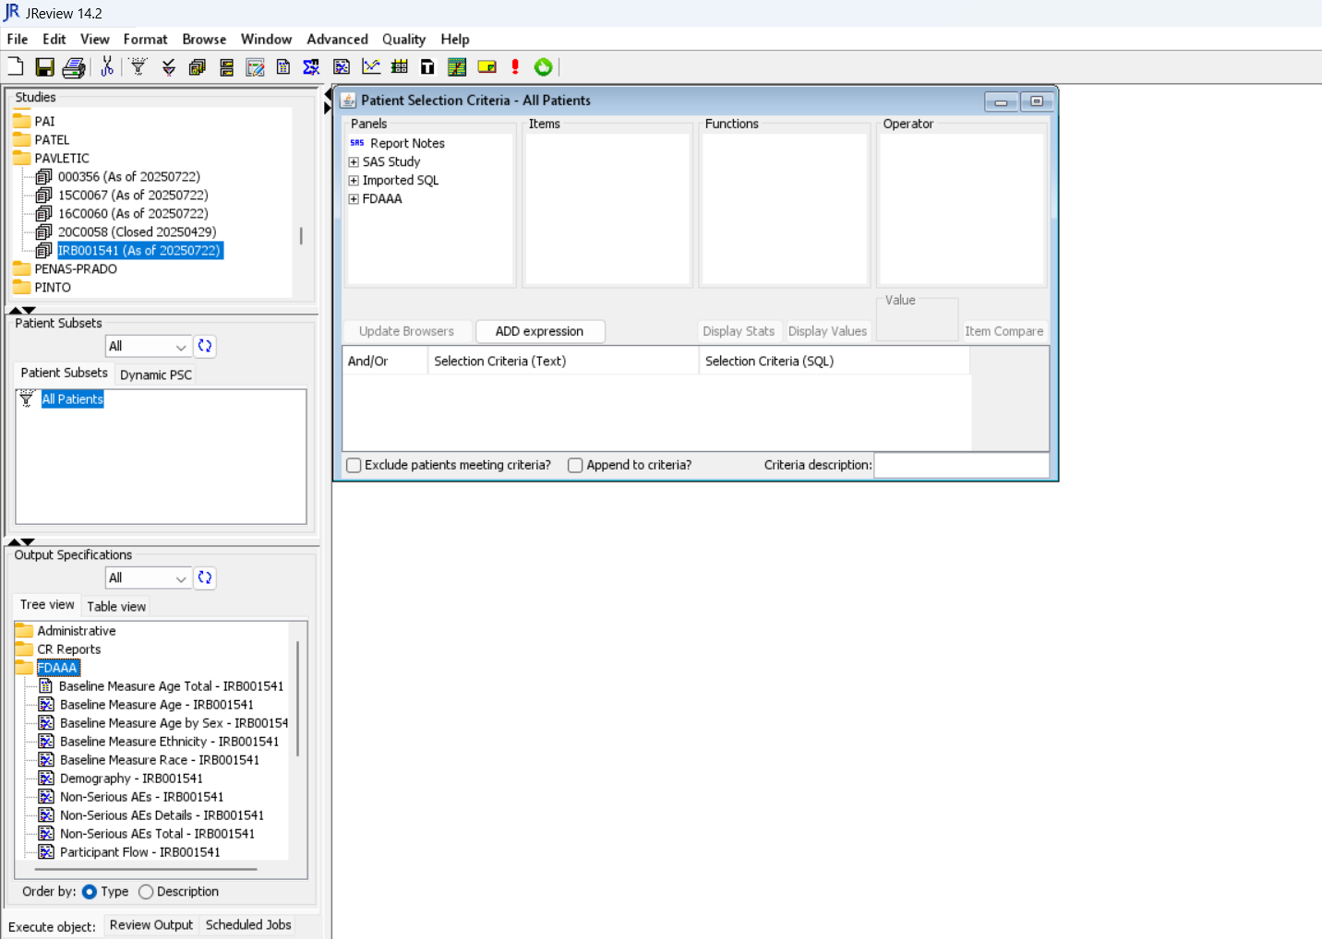
Running Reports – STAT Program
Some complex reports were created through STAT Program upload, they will have a different icon
Double click the report to run

Slide 7
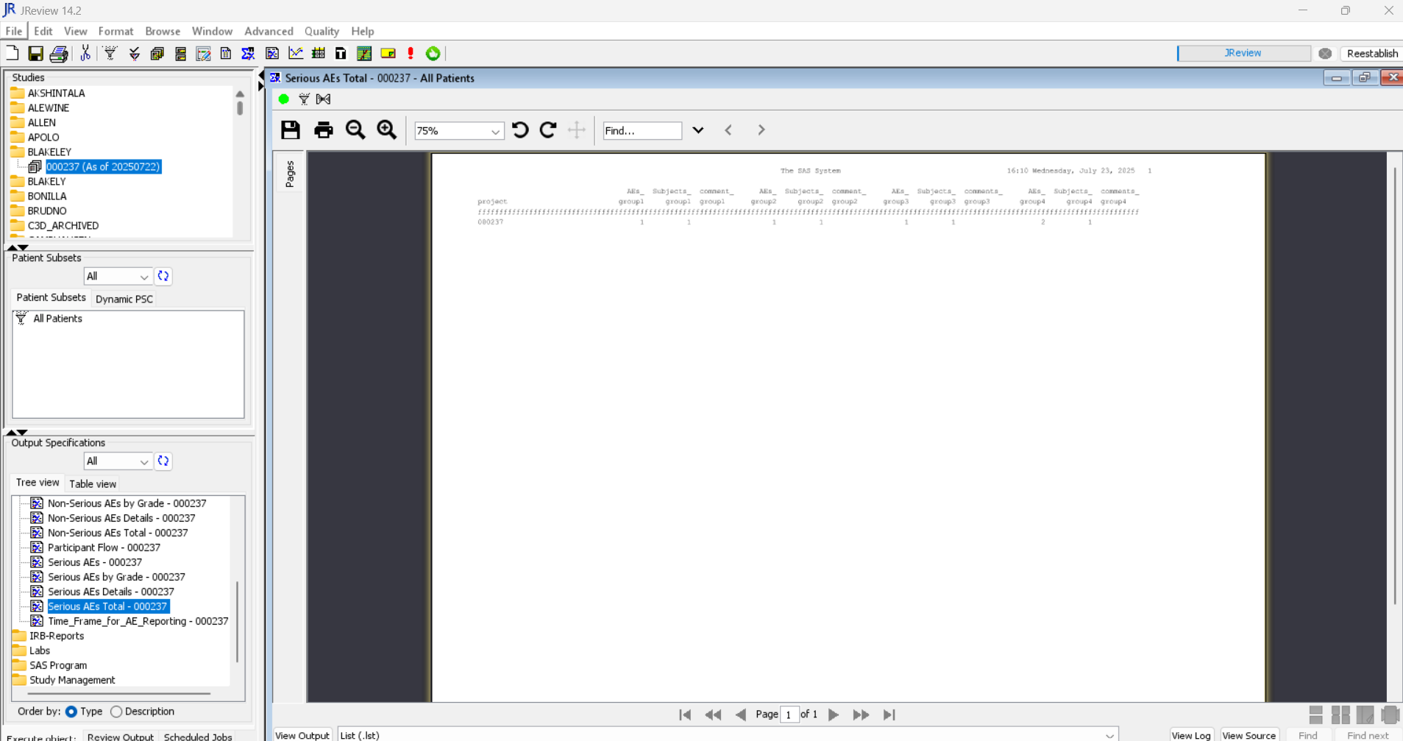
Running Reports – STAT Program (cont.)
The visual appearance of these reports is different from the reports made by report browser. See example below.

Slide 8
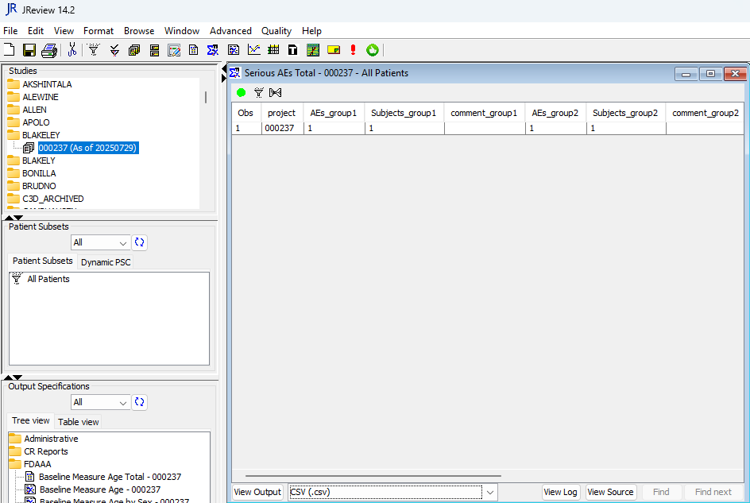
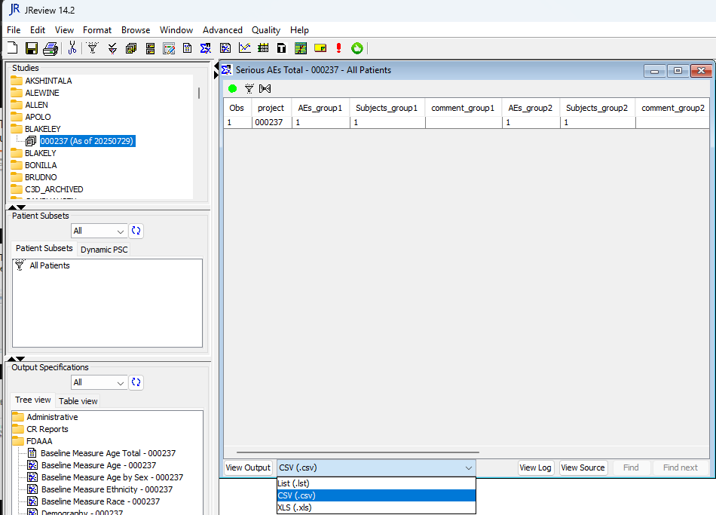
Report - STAT Program – View output
The output can also be viewed in CSV format.
To change the output format to CSV, select “CSV (.csv)” from the View Output dropdown.

Slide 9
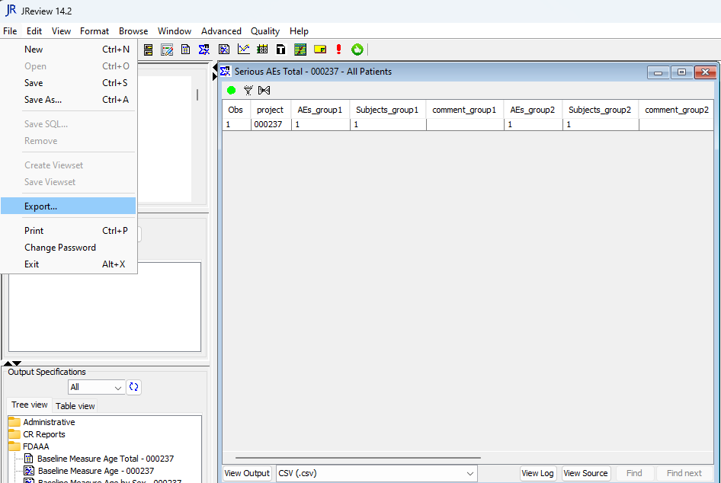
Report - STAT Program – CSV Export
To export in CSV format, make sure CSV is selected in the view output
then click Export in the File dropdown

Slide 10
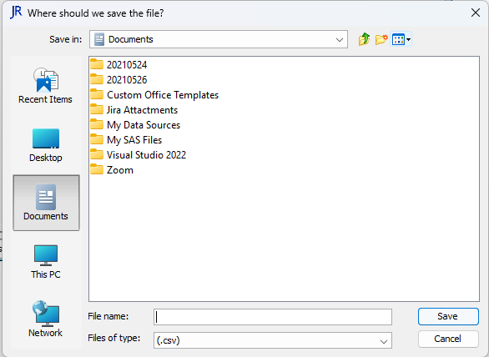
Report - STAT Program – CSV Export (cont.)
When exporting to CSV file, it will directly prompt you with the Save as dialog
Select a location and put in a file name and hit save.

Slide 11
Report - STAT Program – XLS Export
Optionally, these reports can also be exported in xls format
To export, select “XLS (.xls)” from the View Output dropdown

Slide 12
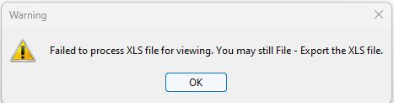
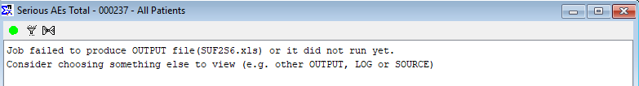
Report - STAT Program – XLS Export (cont.)
  you will receive this warning dialog, click OK
  Then, you will see the report page showing the message below. It is normal that result won’t appear if XLS is selected

Slide 13
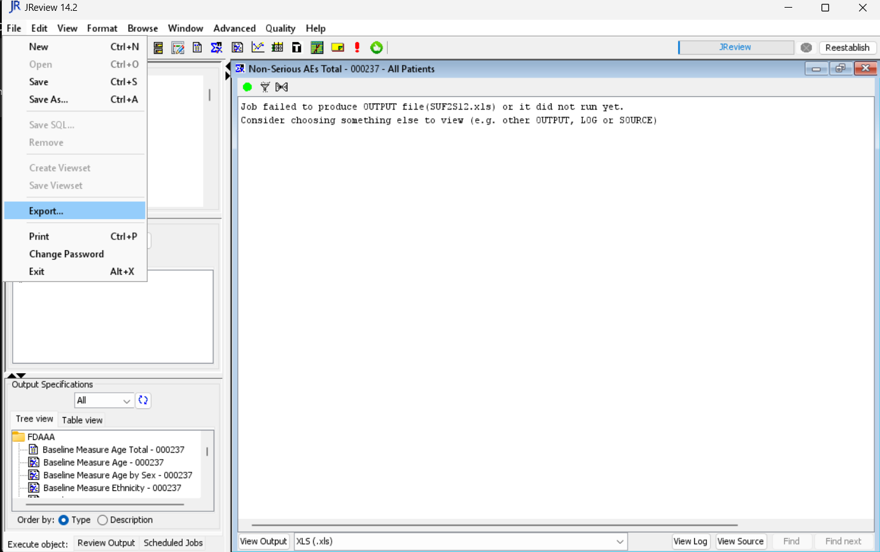
Report - STAT Program – XLS Export (cont.)
  Finally, in the File drop-down menu, click on “Export…”

Slide 14
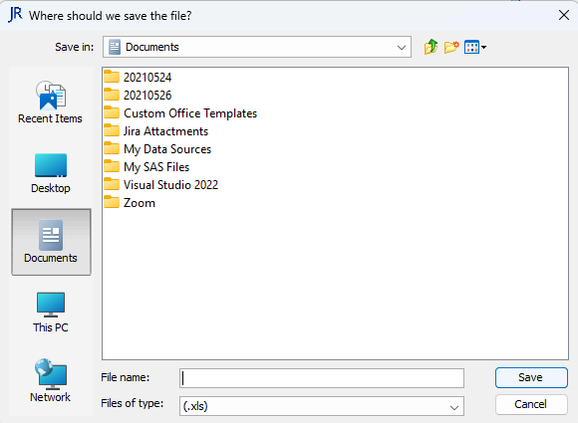

Report - STAT Program – XLS Export (cont.)
  You will be prompt to select a location to save the report. Select and enter a File name, make sure file type is (.xls). Then hit Save.

Slide 15
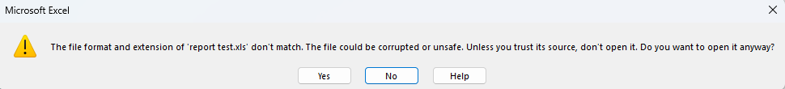
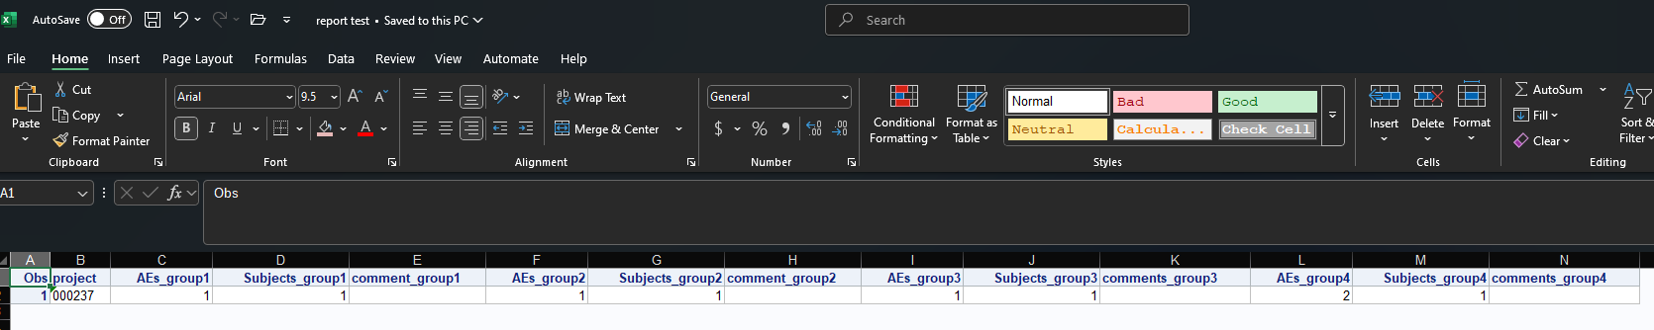
Report - STAT Program – XLS Export (cont.)
When opening the exported file, below warning will show. Click “Yes”
Finally, the report will be opened in xls format through excel

Slide 16
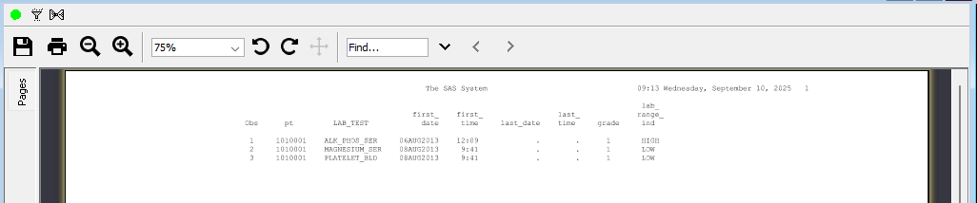

Report - STAT Program – XLS Export (cont.)
Note: For STAT Program report with color-coded cells built, you will have to export to xls format to view the colors.
Example: Lab on grade change report
In SAS Jreview
Export and open in excel

Slide 17
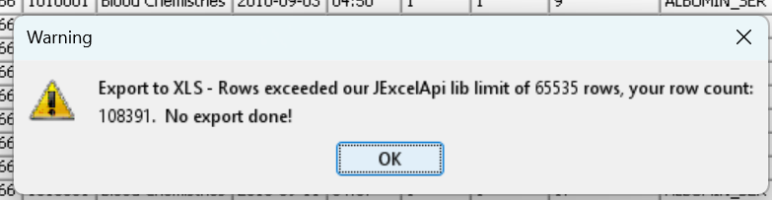
Export limitation
There is a limitation of 65535 rows when exporting to excel.
The warning below will appear if you have more rows than the limit

Slide 18
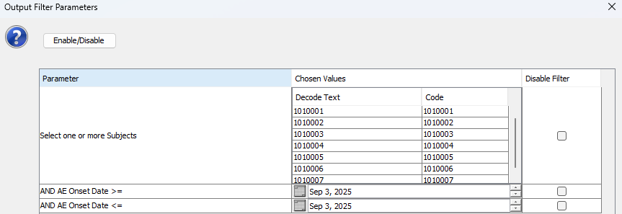
Export Limitation – Resolution : Apply filter
If the number of records exceeds the limitation, apply filters to reduce the output result.
For example, AE Datalisting report allows you to filter on subject and/or onset date. Applying these filters can avoid exceeding the limit

Slide 19
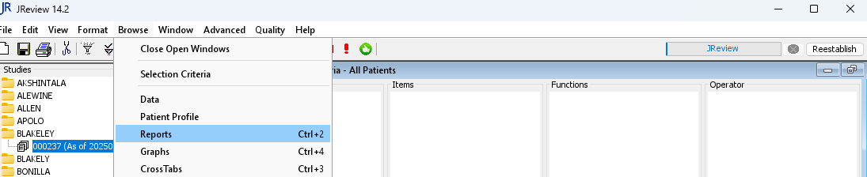
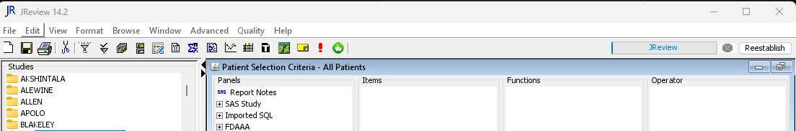
Build report – Report browser
Reports can be built through report browser
- Select “Reports” in the Browse drop down
- Or simply click on the icon below to launch report browser

Slide 20
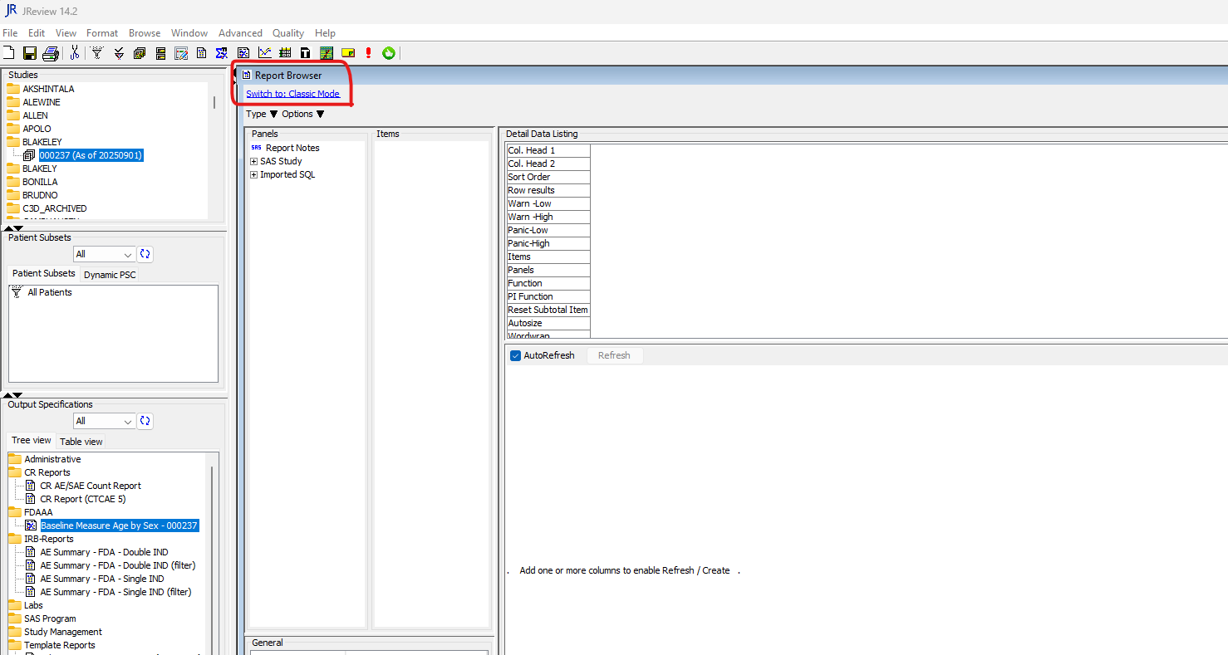
Build report – Report browser (cont.)
Based on your preference, there are two options that you can switch between: Classic Mode and New Mode
(Note: all screenshots in the following steps are taken in “Classic Mode”)

Slide 21
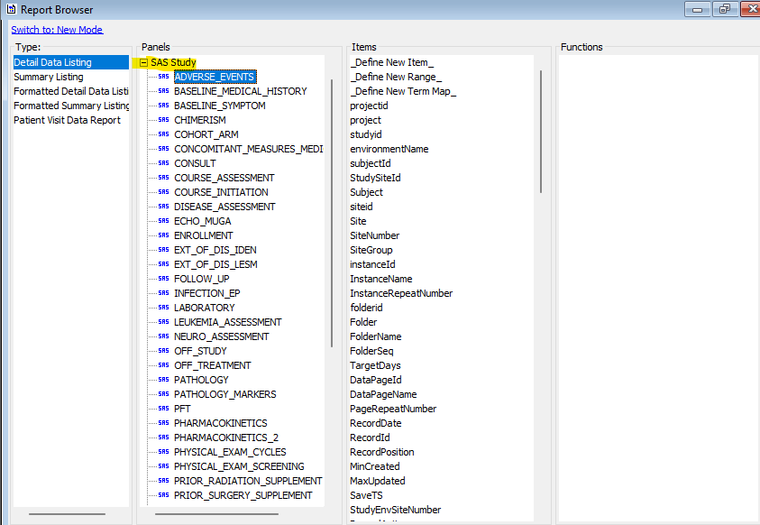
Build report – Report browser (cont.)
Select a Panel (form) and double click the items (fields) to add to report
  Panels
    Refers to forms in EDC
    Expand “SAS Study” to see all the panels
    click on the + icon to expand
  Items
    Refers to fields in a form
    Double click on the item to add
Note: in SAS JREVIEW, expand “SAS Study” category to view all panels

Slide 22
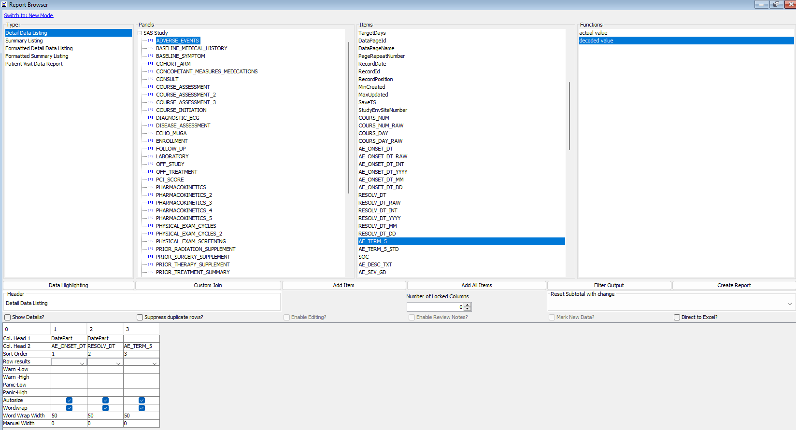
Build report – Report browser (cont.)
Columns added will show in the bottom section of the screen
Double Click on the column header to rename
Double click on sort order to update the order of sorting

Slide 23
Build report – Report browser (cont.)
To browse the result, click Create Report

Slide 24
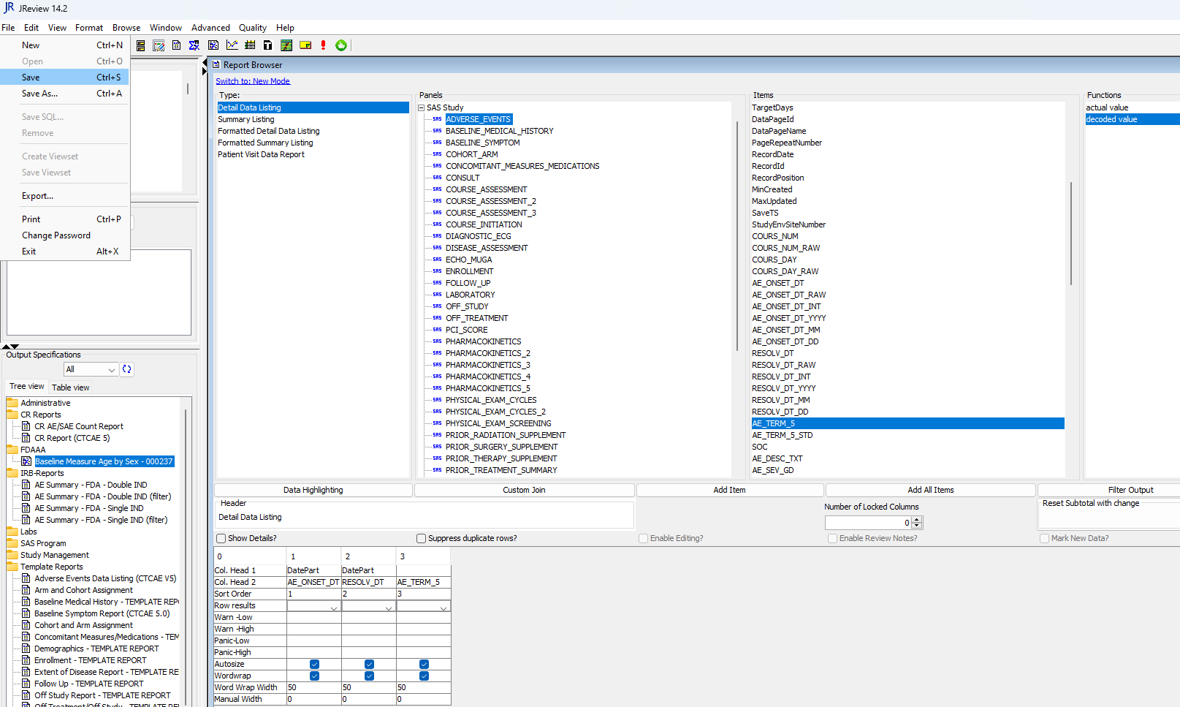
Build report – Report browser (cont.)
To Save, click the “save” from the File dropdown menu

Slide 25
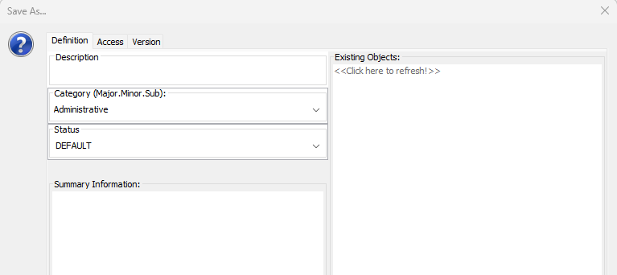
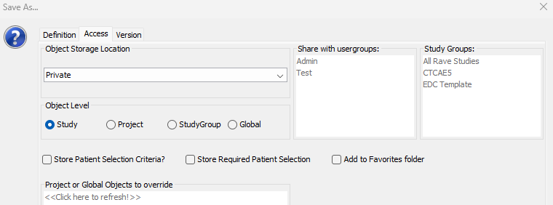

Build report – Report browser (cont.)
Fill in information to save the report
In Definition tab:
Description: Report name
Category: Folder
Status: Select Default
Summary Information: Additional Details (optional)
In Access tab:
Object Storage Location: Private/Public
Object Level: Select Study
Lastly, click Save

Slide 26
Support
For complex reports, please submit a ticket to NCI CBIIT Application Support at NCIAppSupport@mail.nih.gov.
We will be happy to provide support and build the reports per request.

Slide 27
Thank you

