Slide 1
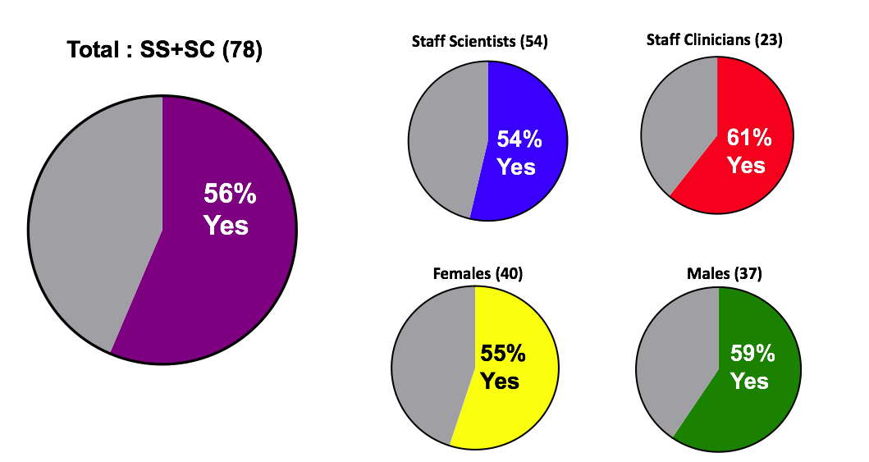
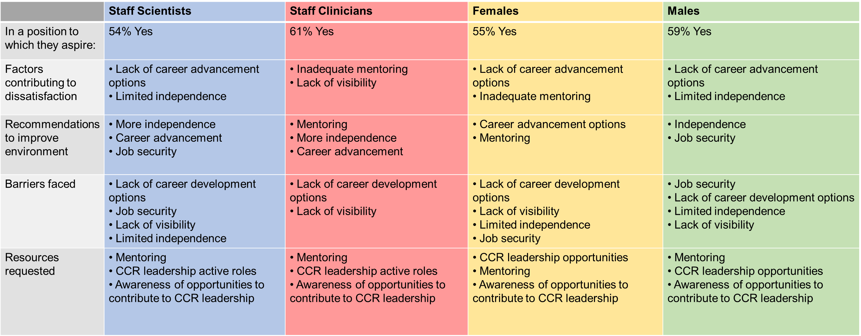
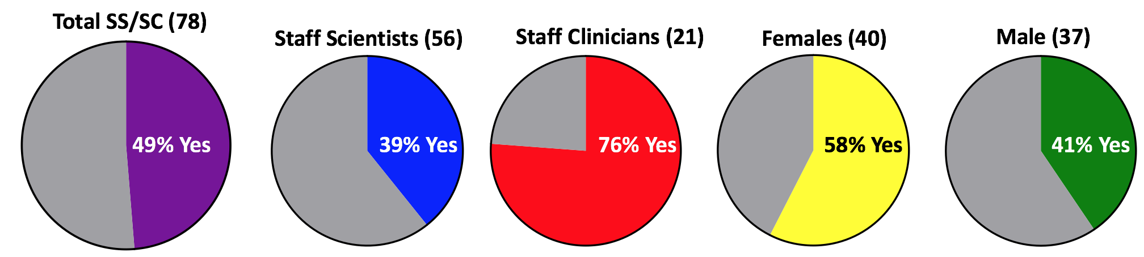
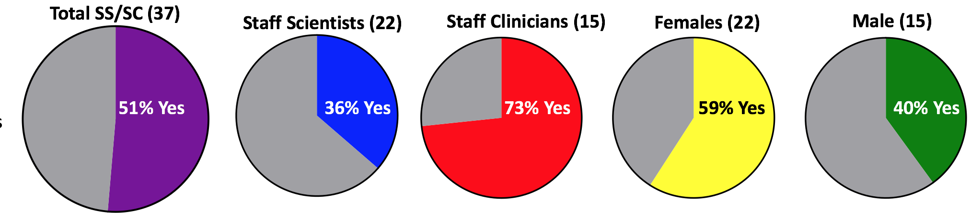
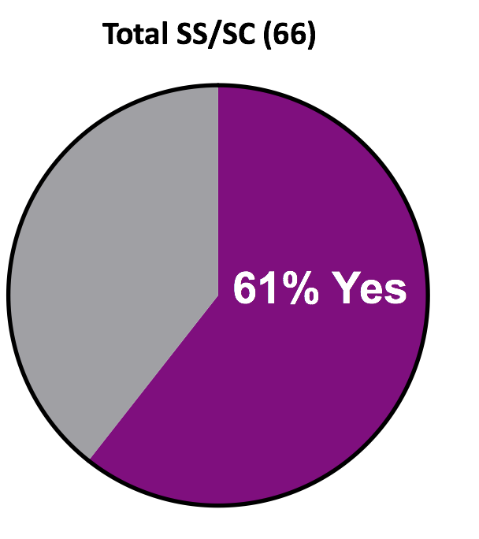
Identifying Career Opportunities and Challenges for CCR SS/SC
Brunilde Gril¹, Elizabeth Vera², Alvina Acquaye², Nirali N. Shah³ and Terri S. Armstrong²
1-Women’s Malignancies Branch; 2- Neuro-Oncology Branch; 3- Pediatric Oncology Branch
Background
Key Questions and Results
Main Concerns
Key Findings
2016: WSA survey highlighted a need for more mentoring for females.
  SSSC participation was limited
2018: SS/SC representation added to NCI WSA
New survey developed to identify career opportunities and challenges experienced by SSSC
  Male and female participation
At this point in your career, are you in a position you aspire to?
Factors contributing to the fact that the individual is not at a position she/he aspired to:
SS: Lack of career development and limited independence
SC: Inadequate mentoring and lack of visibility
Both Females and Males: Lack of career development opportunities
  Females: Inadequate mentoring
  Males: Limited independence
New concerns identified in the open-ended question:
  Job Security and Quad review
Barriers to Career Advancement
Objectives
Top barrier: Lack of career advancement opportunities
  SS, SC, and females
  Males: Job insecurity as the greatest barrier, followed by lack of career advancement opportunities.
Additional barriers:
  Job insecurity – 2nd main concern emphasized by SS.
  Visibility and independence appeared as the 3rd and 4th concerns shared by both potions and both genders.
Hypothesis: Female SSSCs experience more obstacles to career advancement than males.
Purpose: To collect actionable insights to improve career fulfillment for SSSC.
Survey Development
Recommendations for how CCR/NCI could improve the environment for scientific success and work fulfillment (Open-ended, grouped by theme)
Mentorship
Focused on 4 primary areas:
  Roles and responsibilities
  Obstacles and challenges
  Mentorship
  Career advancement opportunities
Survey launched in January 18th, available until March 1st, 2019
  Approximately 25 questions, all optional
  Anonymous
More SC and females tend to have mentors, compared to SS and males.
>50% SC and females have a mentor outside of their chain of command.
Equal number of SS have formal and informal mentoring.
  A majority of SS have only 1 mentor.
A majority of SC have informal mentoring and several mentors.
  SC and females highlighted the need to have more than 1 mentor.
A majority of women have informal mentoring and more than half have several mentors.
More than half of the men have informal mentoring, and the majority of men has only 1 mentor.
Summary
Survey Analysis
Analyzed by Elizabeth Vera, Alvina Acquaye, Nirali N. Shah, Brunilde Gril and Terri S. Armstrong
Aggregate data were presented to the CCR leadership.
Do you have a mentor?
Do you feel that you need more than one mentor?
Population who Answered the Survey
(n= 92)
 | # Responded | Total in CCR | %
Staff Scientists | 68 | 229 | 29.7%
Female | 31 | 89 | 34.8%
Male | 34 | 140 | 24.3%
Staff Clinicians | 24 | 51 | 47%
Female | 15 | 25 | 60%
Male | 9 | 26 | 34.6%
Do you feel that you’ve faced barriers to your success?
What do you feel are the biggest barriers faced by a SS or a SC at the CCR?
Next Steps
Mentorship:
  Goals are to meet the needs for SC/females
  SS/SC Enrichment Program developed by Ofelia Olivero, CCT, NCI - includes formal mentoring, WSA commitment
Career advancement
  The AOS is discussing career advancement opportunities for SS across NIH.
  Improve visibility, change title of “staff”
Job Security: placement into new lab” program presented by Chris Corey during the 2017 SSSC Professional Development day
Acknowledgements
We thank Drs. Lakshmi Balagopalan-Bhise, Swati Choksi, Cynthia Masison, Alex Zimmer, Pat Steeg, Mary Kearny, Carol Thiele, Mel Bronez, Laura Hooper and Bev Mock for their feedback on developing the questionnaires, as well as the Staff Clinician Council.

