Slide 1
Introduction to Results Information Reporting
Lisa King, LVN, CCRP
Program Analyst
National Cancer Institute
Office of the Clinical Director
Center for Cancer Research
11/13/23

Slide 2
What is FDAAA?
Food and Drug Administration (FDA) Amendments Act, Section 801
Established in 2007
Requires registration and reporting of information on applicable clinical trials (ACTs) on ClinicalTrials.gov
  Controlled clinical investigation, other than a phase I clinical investigation, of a drug subject to section 505 of the Federal Food, Drug, and Cosmetic Act or to section 351of this Act
2016 regulations:
  42 Part 11 - Final Rule for Clinical Trials Regulation and Results Information Submission
  Increase availability of information about clinical trials and clarify FDAAA 801

Slide 3
NIH Policy
Effective January 18, 2017
ALL clinical trials funded by NIH will register and report trial results in Clincaltrials.gov
NIH clinical trial definition:
  A research study in which one or more human subjects are prospectively assigned to one or more interventions (which may include placebo or other control) to evaluate the effects of those interventions on health-related biomedical or behavioral outcomes.
  Interventions include:
    drugs/small molecules/compounds, biologics, devices
    procedures (e.g., surgical techniques)
    delivery systems (e.g., telemedicine, face-to-face interviews)
    strategies to change health-related behavior (e.g., diet, cognitive therapy, exercise, development of new habits)
    treatment strategies
    prevention strategies
    diagnostic strategies

Slide 4
Why do we report?
It’s the law
Inform clinicians and the public about clinical trial results
  Transparency
    Report positive and negative trials
  Reduce redundancy

Slide 5
Role of OPS in Complying with FDAAA & NIH Policy
Serve as the Intramural Liaison for Clinicaltrials.gov
Serve as Administrator for Protocol Registration System (PRS)
  Register Protocols
    Send PI ClinicalTrials.gov registration alert
    Send PI reminders for results information reporting
    Serve as the “Responsible Party”
    When it is time to report results, switch RP to PI and send ClinicalTrials.gov log-in information
Monitor for Compliance

Slide 6
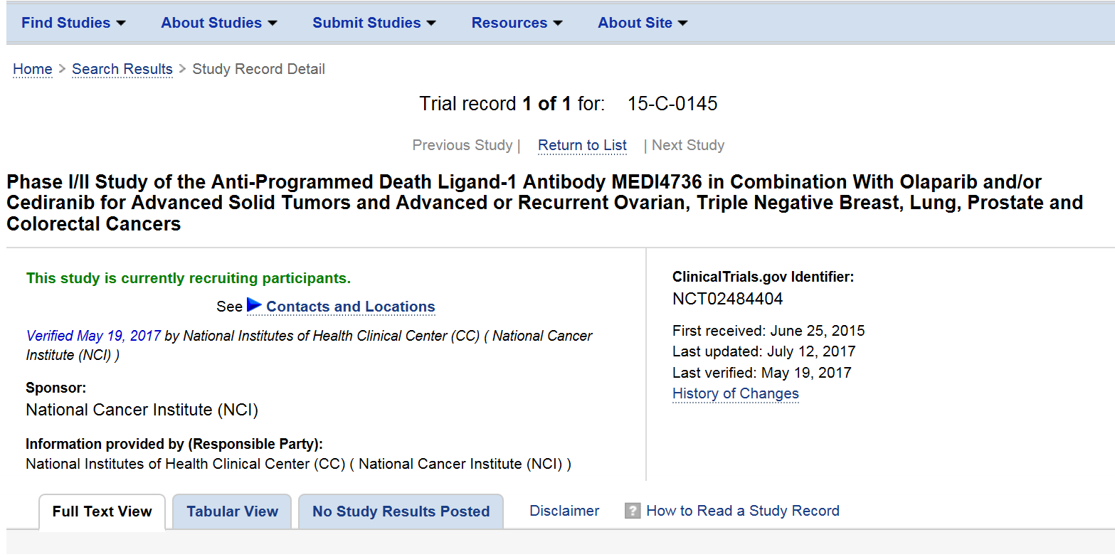
Protocols Posted by NIHCC

Slide 7
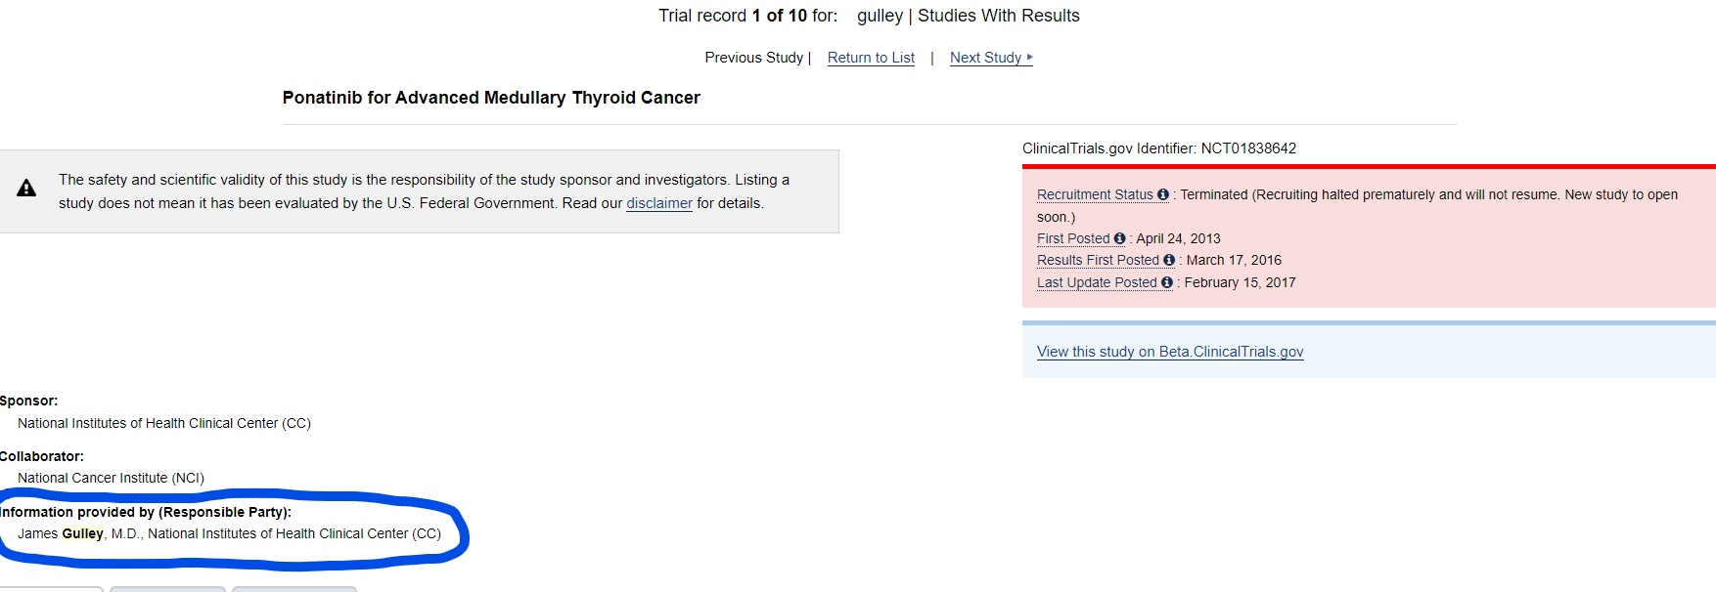

Slide 8
Updating Protocol Information
Nightly feed from Clinical Center’s Protrak Query System (PQS)
  Continuing Review/Amendments
  Primary completion date (PCD)/study completion date (SCD) updates submitted by the Protocol Support Office (PSO) in PQS

Slide 9
When do we report results data?...
Initial results must be reported within 1 year of the primary completion date
  Date that the final subject was examined or received an intervention for the purposes of final collection of data for the primary outcome
  (2) primary outcomes: report when ALL primary outcomes are completed.
  Drug company withdrew drug, PI decided to close study due to slow accrual, PI took over study from a PI who departed the NIH, for example, do not change the reporting deadline. In this case, a study can be out of compliance due to a PCD in the past or have a limited time to report before the deadline

Slide 10
…When do we report results data?
Once the clinical study has reached the study completion date, update the Study Completion Date to reflect the actual study completion date
  Date the final participant was examined or received an intervention for purposes of final collection of data for the primary and secondary outcome measures and adverse events
Results information reporting begins ~3~4 months before it is due.
  Holidays and leave are taken into consideration so may be >4 months

Slide 11
Good Cause Extension (GCE)
Submitted by Program Analyst via the ClinicalTrials.gov Protocol Registration and Results System (PRS) at any time prior (i.e., the day before) to the results reporting deadline
Requires approval by the Clinical Director and Acting Chief Scientific Officer
NLM approves/disapproves on a case-by-case basis; can take up to 45 days to respond
PI can appeal if disapproved

Slide 12
*Considerations for GCE
May be good cause:
  Scientific integrity
  Emergency (e.g., natural disaster, death)
  Study terminated near submission deadline
May not be good cause:
  Study not published
  Pending regulatory/health agency review
  Analysis not complete
  Insufficient planning (e.g., PI departing the NIH)
*Clinical Trials Results Information Submission: Good Cause Extension Request Process and Criteria

Slide 13
What do we report?
Administrative data
Baseline Characteristics
Participant Flow
Outcome Measures
  Statistical Analysis
Adverse Events (Serious and Other (i.e., Non-Serious)
Upload protocol and consent (last version)
  Ensure tech transfer… agreement allows this
  CCR will not redact unless requested
    See Monday Morning Practice Pearls (M2P2) #78 if you want to redact

Slide 14
What is the Role of the PI?
Ensure study data is setup properly in C3D
Know location of data (i.e., C3D, RAVE)
Routinely QA data
Designate a results reporting POC
Provide, review and/or edit results data
  Identify the primary and secondary outcome measure data/format
Approve and Release record on the PRS
Before departing the NCI, report results data (if applicable) and seek out a new RP

Slide 15
What documents will the PI be asked for?
Publications/manuscripts
Abstracts
Oral presentations
Excel spreadsheets
Other data
Lisa requests of ASRC Federal a FDAAA report from J-review
  Participant flow data
    Demographic
    Reason off study
  Baseline characteristics
  AE’s

Slide 16
What happens after we report the data?
Clinicaltrials.gov QC Review
  30 days
  Clinicaltrials.gov may review publications and protocol information against data reported
RP will be notified via email that PRS Comments are available for review and action
    Major
    Advisory
  25 days to respond to comments

Slide 17
Posting results
NLM will publicly post submitted results
  Within 30 days of submission
  Regardless of whether quality control (QC) review has been completed
    Also, Major comments about relevant sections
      Note about the QC process
Record updated on Clinicaltrials.gov – this then makes the data available to the public

Slide 18
*FDA: Potential Penalties
Failure to submit results information on time and/or submitting false or misleading information, etc.
  A)Pre-Notice letter; B)Notice of Non-Compliance
    10K a day (civil action)
    Criminal action
    Withhold grant funds
    *Civil Money Penalties Relating to the ClinicalTrials.gov Data Bank | FDA

Slide 19
*NIH Policy Manual 3007 – Clinical Trial Registration and Results Information Reporting
Consequences:
No sign off on Scientific Reviews of any new protocols until you are compliant
Notification to your IC Director
Letter of reprimand and may impact your PMAP evaluation
Other consequences for non-compliance after 30 days (e.g., removal from Federal service for non-compliance with the Manual Chapter)
*3007 - Clinical Trial Registration and Results Information Reporting (nih.gov)

Slide 20
The Internet and Social Media
FDAAA Trials Tracker
  Oxford University team tracks compliance with FDAAA results reporting (e.g., overdue, reported late) and posts to their website
Twitter
  Delinquent data from the FDAAA Trials Tracker can be tweeted and shared with the public

Slide 21
Things to keep in mind during a clinical trial life cycle
Location of data
Routinely QA data
Designate a results reporting POC
Identify the primary and secondary outcome measure data/format
Results reporting begins ~3-4 months before it is due.
  Holidays and leave are taken into consideration so may be >4 months

Slide 22
Example
12-C-0056

Slide 23
M2P2 Resources
M2P2 #41: What is the primary completion date (PCD) and the anticipated completion date (ACD)? Why are these dates important?
M2P2 #76: Who should be notified when a primary completion date (PCD) is met for one of my clinical trials?
M2P2 #77: What is a Good Cause Extension (GCE) for reporting results in ClinicalTrials.gov?
M2P2 #78: Is it mandatory to redact certain information from a protocol and/or consent for results reporting to ClinicalTrials.gov?

Slide 24
Resources
ClinicalTrials.gov https://clinicaltrials.gov/ct2/manage-recs/fdaaa
Results Templates and Examples https://prsinfo.clinicaltrials.gov/results_table_layout/ResultSimpleForms.html
NIH Sourcebook https://oir.nih.gov/sourcebook/intramural-program-oversight/intramural-data-sharing/guide-fdaaa-reporting-research-results
Trial Reporting in ClinicalTrials.gov-The Final Rule http://www.nejm.org/doi/full/10.1056/NEJMsr1611785#t=article

Slide 25
Resources
FDAAA Trials Tracker
fdaaa.trialstracker.net/
Civil Money Penalties Relating to CT.gov Databank https://www.fda.gov/media/113361/download
Seife et al. v. HHS et al. https://clinicaltrials.gov/ct2/manage-recs/faq#fr_41
FAQ’s on ClinicalTrials.gov https://www.clinicaltrials.gov/ct2/manage-recs/faq

Slide 26
Contact Information
Lisa King
  Phone: 240-760-6019
  Email: kingl@mail.nih.gov

Slide 27
Thank you!

