Slide 1

Dimension Reduction Methods:
From PCA To TSNE And UMAP
Maxwell Lee
High-dimension Data Analysis Group
Laboratory of Cancer Biology and Genetics
Center for Cancer Research
National Cancer Institute
April 16, 2020

Slide 2
Outline Of The Talk
1) Linear dimension reduction methods
PCA, MDS, and SVD
2) Nonlinear dimension reduction methods
Isomap, LLE, Laplacian Eigenmap, TSNE, and UMAP
3) Canonical correlation and Trajectory analysis
Data integration and reversed graph embedding

Slide 3
Data Matrix (Table)
x₁₁ x₁₂ … x_{1p}
x₂₁ x₂₂ … x_{2p}
. .
. .
x_{n1} x_{n2} … x_{np}
X_{np}
n observations and p variables

Slide 4
Multivariate Linear Regression Model
y is response variable or dependent variable
x₁...x_{p} are independent variables
y₁ x₁₁ x₁₂ … x_{1p}
y₂ x₂₁ x₂₂ … x_{2p}
. .
. .
y_{n} x_{n1} x_{n2} … x_{np}
y = β₀ + β₁x₁ + β₂x₂ … + β_{p}x_{p} + ε
y = Xβ + ε

Slide 5
Application Of Simple Linear Regression Model
y = β₀ + β₁x + ε
y | x | application
Tumor size | Gene expression | correlation
Gene expression | Treatment vs control | t-test
Treatment response | Gene expression | Classification (glm )

Slide 6
Unsupervised Analysis
x₁₁ x₁₂ … x_{1p}
x₂₁ x₂₂ … x_{2p}
. .
. .
x_{n1} x_{n2} … x_{np}
We do not have data for response variable y or sample label
We are more interested in intrinsic relationship among samples

Slide 7
Supervised And Unsupervised Statistical Learning
continuous variable
Regression model
linear regression, polynomial regression, glm
supervised
Classification
Logistic regression, LDA, random forest, gbm
categorical variable
Clustering analysis
hierarchical clustering, k-means
unsupervised
Dimension reduction
PCA, MDS, t-SNE

Slide 8
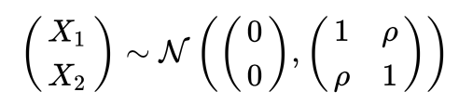
Principal Component Analysis (PCA)
r = ρ
n = 400

Slide 9
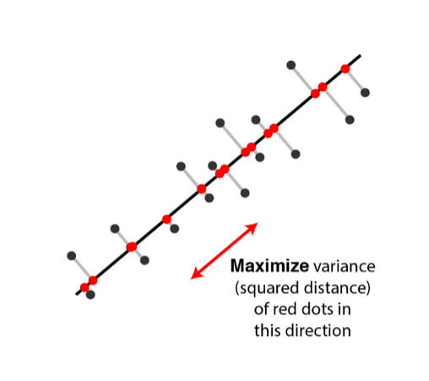
Principal Component Analysis (PCA)
PC1
PC2
x2
x1
Karl Pearson 1901; Harold Hotelling 1933-1936

Slide 10
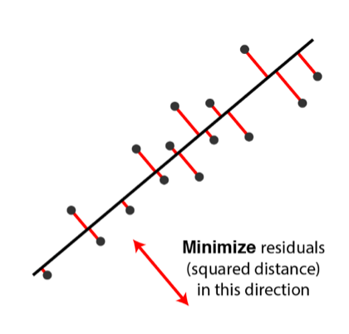
Principal Component Analysis (PCA)
PC1
PC2
x2
x1
Karl Pearson 1901

Slide 11
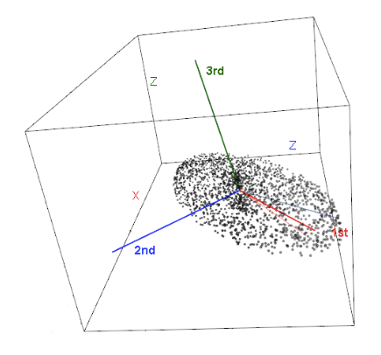
Principal Component Analysis (PCA)

Slide 12
Geometric View Of PCA: Rotation Of Coordinates
45⁰
PC1
PC2
r = ρ
n = 100

Slide 13
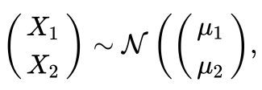
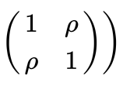
PCA: Samples With Two Groups
ρ = 0
group1
μ₁ = (0, 0, 0, 0)
μ₂ = (0, 0, 0, 0)
group2
μ₁ = (0, 3, 6, 20)
μ₂ = (0, 3, 6, 20)

Slide 14
45⁰
PCA: Samples With Two Groups
PC1
PC2
ρ = 0
group1
μ₁ = (0, 0)
μ₂ = (0, 0)
group2
μ₁ = (3, 6)
μ₂ = (3, 6)

Slide 15

PCA: Samples With Three Groups
σ_{ii} = 1
σ_{ij} = 0
group1
μ₁ = (0, 0, 0, 0)
μ₂ = (0, 0, 0, 0)
group2
μ₁ = (0, 3, 6, 20)
μ₂ = (0, 0, 0, 0)
group3
μ₁ = (0, 0, 0, 0)
μ₂ = (0, 3, 6, 20)

Slide 16
PCA: Samples With Three Groups
45⁰
σ_{ii} = 1
σ_{ij} = 0
PC1
PC2
group1
μ₁ = (0, 0)
μ₂ = (0, 0)
group2
μ₁ = (6, 20)
μ₂ = (0, 0)
group3
μ₁ = (0, 0)
μ₂ = (6, 20)

Slide 17
Variance Accounted For By PC1

Slide 18
PCA Analysis Of TCGA Breast Cancer Data
How does PCA identify PC1 from RNAseq data?

Slide 19
Algorithm of PCA
z₁ = Xw₁
z₂ = Xw₂
z₃ = Xw₃
Z = XW
var(Z) = (XW)^{T}XW
var(Z) = W^{T}X^{T}XW = W^{T}SW
Choose w to maximize w^{T}Sw
subject to W^{T}W = I

Slide 20
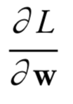
Algorithm of PCA
Choose w to maximize w^{T}Sw
subject to W^{T}W = I
L(w, λ) = w^{T}Sw – λ(w^{T}w – 1)
= 2Sw – 2λw
Sw = λw
w is the eigenvector and λ is eigenvalue

Slide 21
Properties Of Eigen Values And Eigen Vectors
Covariance matrix S
There are p pairs of Eigen values and Eigen vectors
Eigen values are ranked from the largest to smallest
For covariance matrix, all eigen values are nonnegative

Slide 22
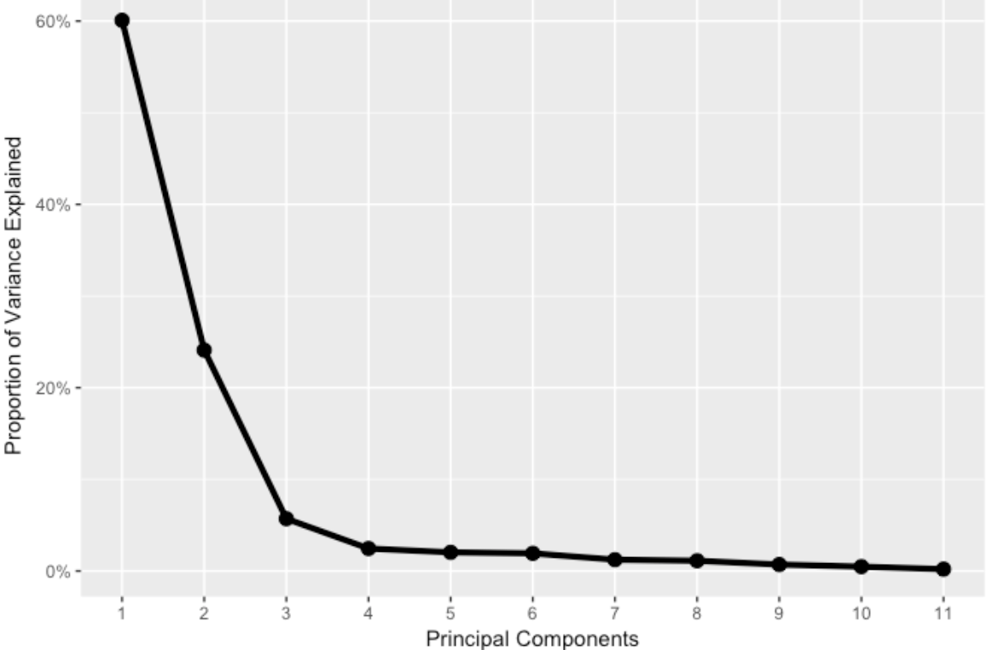
Variance of PCs Are Eigen Value And Are Additive
var(z) = w^{T}Sw
= w^{T}λw
= λ
var(Z) = λ₁ + λ₂ … + λ_{p}

Slide 23
Singular Value Decomposition (SVD)
Z = XW
Z_{s} = XWD^{-1/2}
Z_{s}D^{1/2}W^{T} = X
X = Z_{s}D^{1/2}W^{T}
X = UΣV^{T}

Slide 24
Right and Left Eigen Vectors Of SVD
X = UΣV^{T}
X^{T}X = VΣU^{T}UΣV^{T}
= VΣ²V^{T}
XX^{T} = UΣV^{T}VΣU^{T}
= UΣ²U^{T}

Slide 25
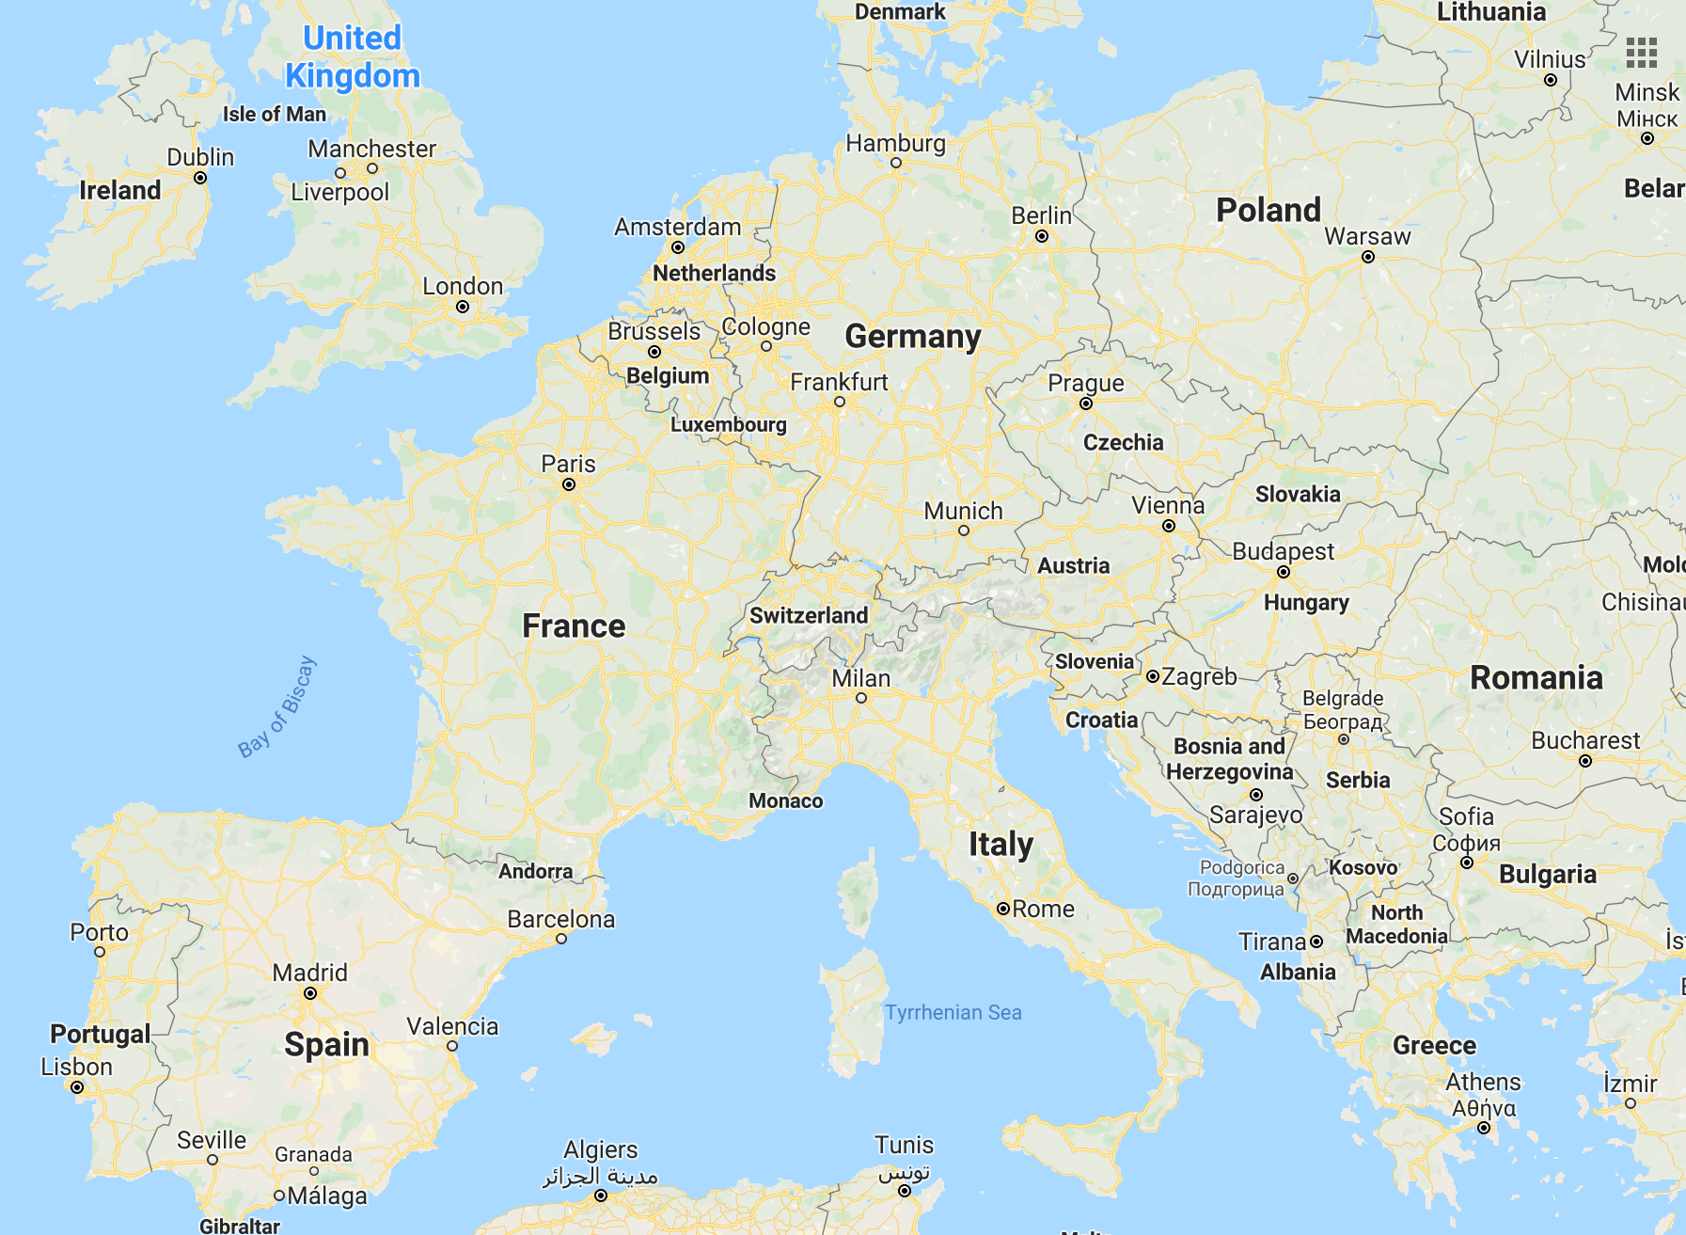
Multidimensional Scaling (MDS)

Slide 26
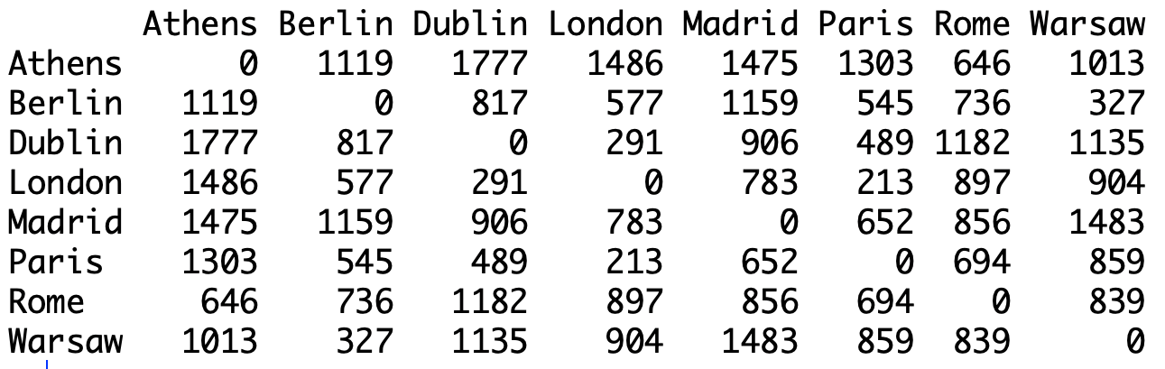
Multidimensional Scaling (MDS)
Pairwise Distance Matrix

Slide 27
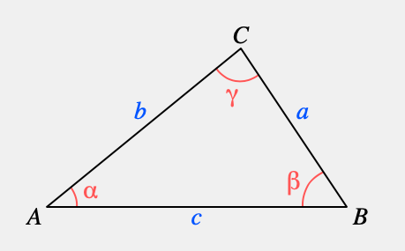
Multidimensional Scaling (MDS)
Law of cosine
a² = b² + c² – 2bc cos(α)
2bc cos(α) = b² + c² – a²
bc cos(α) = -½(a² - b² + c²)
b•c = bc cos(α)
b•c = -1/2(a² – b² –c²)
O

Slide 28
Multidimensional Scaling (MDS)
b•c = -1/2(a² – b² –c²)
K₁₁ K₁₂ … K_{1n}
K₂₁ K₂₂ … K_{2n}
. .
. .
K_{n1} K_{n2} … K_{nn}
K = UΛU^{T}
Z = UΛ^{1/2}

Slide 29
MDS And PCA Are Equivalent
Z = UΛ^{1/2}
X = UΣV^{T}
X^{T}X = VΣ²V^{T}
XX^{T} = UΣ²U^{T}
XV = UΣ
Z = UΛ^{1/2}

Slide 30
Multidimensional Scaling (MDS)

Slide 31
Multidimensional Scaling (MDS)

Slide 32
Outline Of The Talk
1) Linear dimension reduction methods
PCA, MDS, and SVD
2) Nonlinear dimension reduction methods
Isomap, LLE, Laplacian Eigenmap, TSNE, and UMAP
3) Canonical correlation and Trajectory analysis
Data integration and reversed graph embedding

